Slide 1

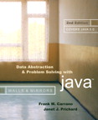
Chapter 1
Review of Java Fundamentals

Slide 2

Program Structure
Typical Java program consists of
  User written classes
  Java Application Programming Interface (API) classes
Java application
  Has one class with a main method
Java program basic elements:
  Packages
  Classes
  Data fields
  Methods

Slide 3
Packages
Provide a mechanism for grouping related classes
package statement
  Indicates a class is part of a package
Java assumes all classes in a particular package are contained in same directory
Java API consists of many predefined packages

Slide 4
Packages
import statement
  Allows you to use classes contained in other packages
Package java.lang is implicitly imported to all Java code

Slide 5
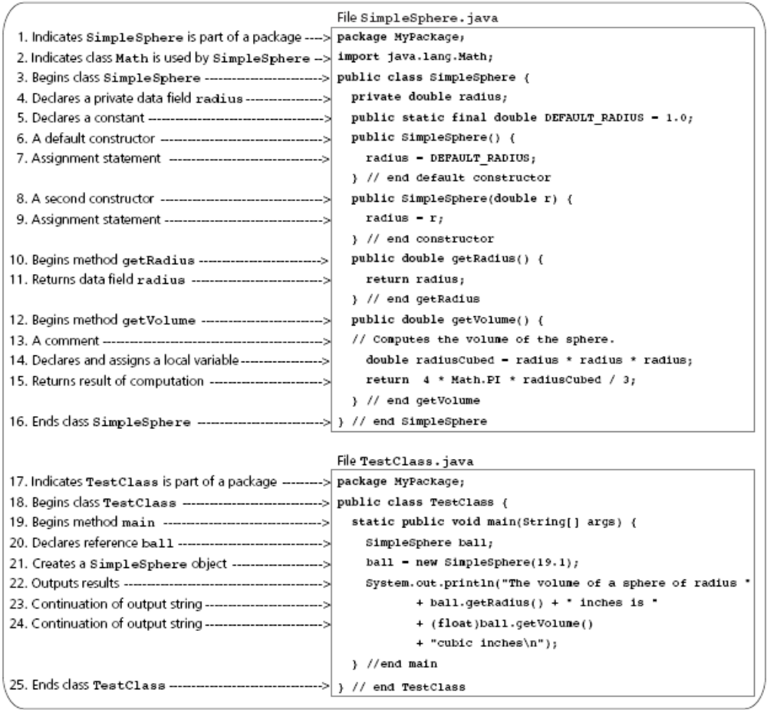
Packages
Figure 1-1
A simple Java Program

Slide 6
Classes
Data type that specifies data and methods available for instances of the class
An object in Java is an instance of a class
Class definition includes
  Optional subclassing modifier
  Optional access modifier
  Keyword class
  Optional extends clause
  Optional implements clause
  Class body

Slide 7
Classes
Every Java class is a subclass of either
  Another Java class
  Object class
new operator
  Creates an object or instance of a class

Slide 8
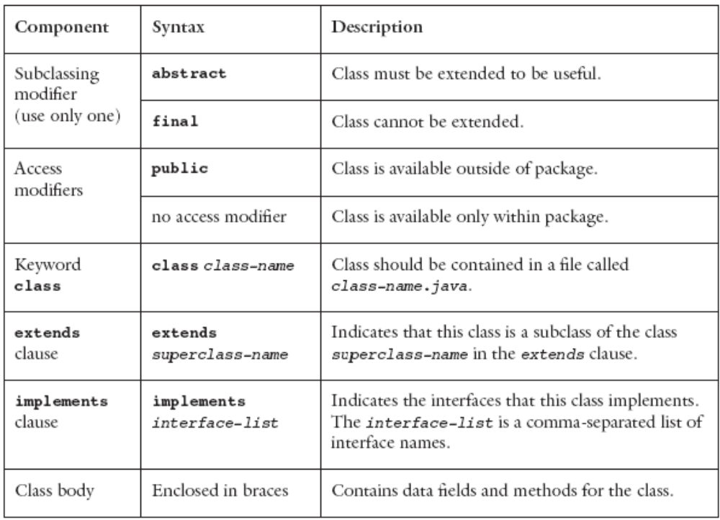
Classes
Figure 1-2
Components of a class

Slide 9
Data Fields
Class members that are either variables or constants
Data field declarations can contain
  Access modifiers
  Use modifiers
  Modules

Slide 10
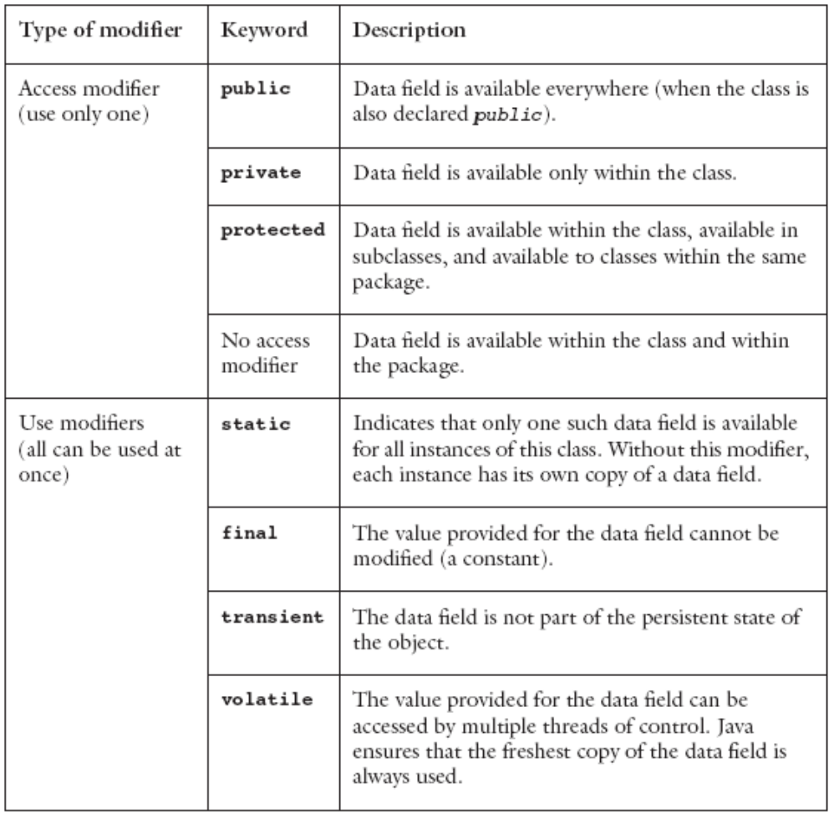
Data Fields
Figure 1-3
Modifiers used in data field declarations

Slide 11
Methods
Used to implement operations
Should perform one well-defined task
Method modifiers
  Access modifiers and use modifiers
Valued method
  Returns a value
  Body must contain return expression;

Slide 12
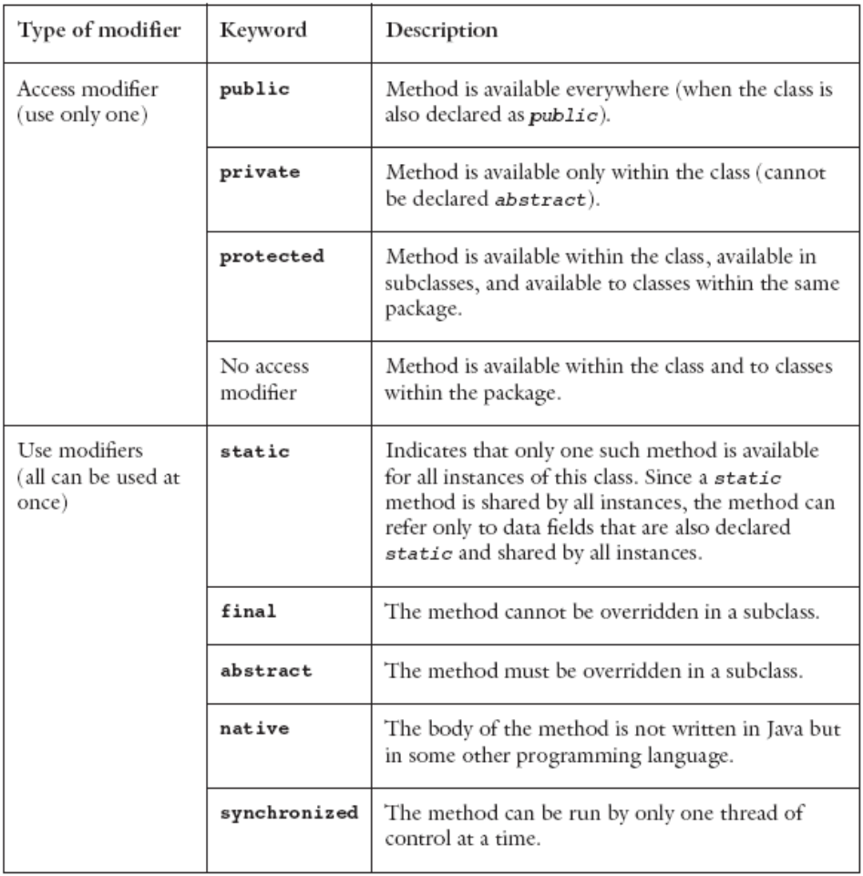
Method Modifiers
Figure 1-4
Modifiers used in a method declaration

Slide 13
Methods
Syntax of a method declaration
  access-modifier use-modifiers return-type
  method-name (formal-parameter-list) {
  method-body
  }
Arguments are passed by value
  Except for objects and arrays
    A reference value is copied instead
Java 1.5 allows a method to have a variable number of arguments of the same type
  Using the ellipses (three consecutive dots)

Slide 14
Methods
Constructor
  Special kind of method
  Has the same name as the class and no return type
  Executed only when an object is created
A class can contain multiple constructors

Slide 15
How to Access Members of an Object
Data fields and methods declared public
  Name the object, followed by a period, followed by member name
Members declared static
  Use the class name, followed by a period, followed by member name

Slide 16
Language Basics
Java application
  Collection of classes
    One class contains the main method
Java programs can also be written as applets

Slide 17
Comments
Comment line
  Begins with two slashes (//)
  Continues until the end of the line
Multiple-line comment
  Begins with /* and ends with */
  Useful for debugging
  Cannot contain another multiple-line comment
javadoc comments
  Begins with /** and ends with */

Slide 18
Identifiers and Keywords
Identifier
  Sequence of letters, digits, underscores, and dollar signs
  Must begin with either a letter or underscore
  Used to name various parts of the program
  Java distinguishes between uppercase and lowercase letters
Keywords
  Java reserved identifiers

Slide 19
Variables
Represents a memory location
Contains a value of primitive type or a reference
Its name is a Java identifier
Declared by preceding variable name with data type
  double radius; // radius of a sphere
  String name; // reference to a String object

Slide 20
Primitive Data Types
Organized into four categories
  Boolean
  Character
  Integer
  Floating point
Character and integer types are called integral types
Integral and floating-point types are called arithmetic types

Slide 21
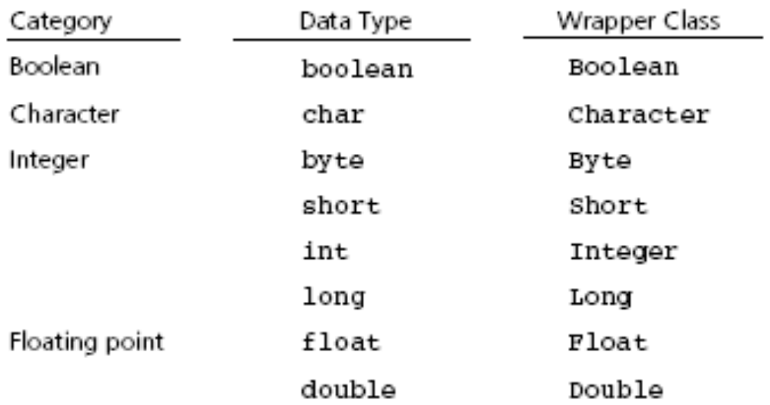
Primitive Data Types
Figure 1-5
Primitive data types and corresponding wrapper classes

Slide 22
Primitive Data Types
Value of primitive type is not considered an object
java.lang provides wrapper classes for each of the primitive types
Autoboxing
  Automatically converts from a primitive type to the equivalent wrapper class
Auto-unboxing
  Reverse process

Slide 23
References
Data type used to locate an object
Java does not allow programmer to perform operations on the reference value
Location of object in memory can be assigned to a reference variable

Slide 24
Literal Constants
Indicate particular values within a program
Used to initialize the value of a variable
Decimal integer constants
  Do not use commas, decimal points, or leading zeros
  Default data type is either int or long
Floating constants
  Written using decimal points
  Default data type is double

Slide 25
Literal Constants
Character constants
  Enclosed in single quotes
  Default data type is char
  Literal character strings
    Sequence of characters enclosed in double quotes

Slide 26
Named Constants
Have values that do not change
Declared as a variable but using the keyword final

Slide 27
Assignments and Expressions
Expressions
  Combination of variables, constants, operators, and parentheses
Assignment statement
  Example: radius = r;
Arithmetic expression
  Combine variables and constants with arithmetic operators and parentheses
    Arithmetic operators: *, /, %, +, -

Slide 28
Assignments and Expressions
Relational expressions
  Combine variables and constants with relational, or comparison, and equality operators and parentheses
    Relational or comparison operators: <, <=, >=. >
    Equality operators: ==, !=
  Evaluate to true or false

Slide 29
Assignments and Expressions
Logical expressions
  Combine variables and constants of arithmetic types, relational expressions with logical operators
    Logical operators: &&, ||
  Evaluate to true or false
  Short-circuit evaluation
    Evaluates logical expressions from left to right
    Stops as soon as the value of expression is apparent

Slide 30
Assignments and Expressions
Implicit type conversions
  Occur during assignment and during expression evaluation
  Right-hand side of assignment operator is converted to data type of item on left-hand side
  Floating-point values are truncated not rounded
  Integral promotion
    Values of type byte, char, or short are converted to int
  Conversion hierarchy
    int → long → float → double

Slide 31
Assignments and Expressions
Explicit type conversions
  Possible by means of a cast
  Cast operator
    Unary operator
    Formed by enclosing the desired data type within parentheses
Multiple assignments
  Embed assignment expressions within assignment expressions
    Example: a = 5 + (b = 4)
    Evaluates to 9 while b is assigned 4

Slide 32
Assignments and Expressions
Other assignment operators
  -=
  *=
  /=
  %=
  ++
  --

Slide 33
Arrays
Collection of elements with the same data type
Array elements have an order
Support direct and random access
One-dimensional arrays
  Declaration example
    final int DAYS_PER_WEEK = 7;
    double [] maxTemps = new double[DAYS_PER_WEEK];
  Length of an array is accessible using data field length
  Use an index or subscript to access an array element

Slide 34
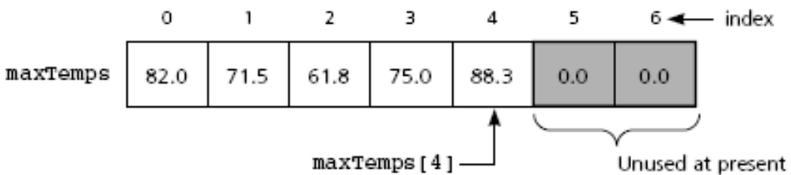
Arrays
Figure 1-7
One-dimensional array of at most seven elements

Slide 35
Arrays
One-dimensional arrays (continued)
  Initializer list example
    double [] weekDayTemps = {82.0, 71.5, 61.8, 75.0, 88.3};
  You can also declare array of object references
Multidimensional arrays
  Use more than one index
  Declaration example
    final int DAYS_PER_WEEK = 7;
    final int WEEKS_PER_YEAR = 52;
    double[][] minTemps = new double[DAYS_PER_WEEK][WEEKS_PER_YEAR];

Slide 36
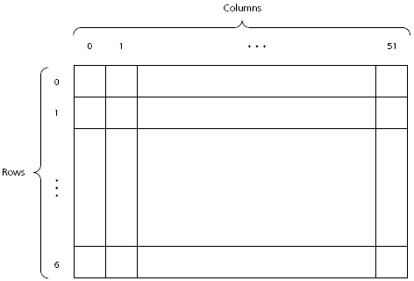
Arrays
Figure 1-8
A two-dimensional array

Slide 37
Arrays
Passing an array to a method
  Declare the method as follows:
    public double averageTemp(double[] temps, int n)
  Invoke the method by writing:
    double avg = averageTemp(maxTemps, 6);
  Location of array is passed to the method
    Cannot return a new array through this value
  Method can modify content of the array

Slide 38
Selection Statements
The if statement
  if (expression)
  statement1
or
  if (expression)
  statement1
  else
  statement2
Nested if
  if (expression) {
  statement1
  }
  else if (expression) {
  statement2
  }
  else {
  statement3
  } // end if

Slide 39
Selection Statements
The switch statement
  switch (integral expression) {
  case 1:
  statement1;
  break;
  case 2, case 3:
  statement2;
  case 4:
  statement3;
  break;
  default:
  statement4;
  } //end of switch

Slide 40
Iteration Statements
The while statement
  while (expression) {
  statement
  }
statement is executed as long as expression is true
statement may not be executed at all
continue expression
  Stops the current iteration of the loop and begins the next iteration at the top of the loop

Slide 41
Iteration Statements
The for statement
  for (initialize; test; update)
  statement
statement is executed as long as test is true
for statement is equivalent to a while statement
The for loop and arrays
  for (ArrayElementType variableName : arrayName)
  statement

Slide 42
Iteration Statements
The do statement
  do {
  statement
  } while (expression);
statement is executed until expression is false
do statement loops at least once

Slide 43
Useful Java Classes
The Object class
  Java supports a single class inheritance hierarchy
    With class Object as the root
  More useful methods
    public boolean equals(Object obj)
    protected void finalize()
    public int hashCode()
    public String toString()

Slide 44
Useful Java Classes
String classes
  Class String
    Declaration examples:
      String title;
      String title = “Walls and Mirrors”;
    Assignment example:
      Title = “Walls and Mirrors”;
    String length example:
      title.length();
    Referencing a single character
      title.charAt(0);
    Comparing strings
      title.compareTo(string2);

Slide 45
Useful Java Classes
String classes (continued)
  Class String
    Concatenation example:
      String monthName = "December";
      int day = 31;
      int year = 02;
      String date = monthName + " " + day + ", 20" + year;

Slide 46
Useful Java Classes
String classes (continued)
  Class StringBuffer
    Creates mutable strings
    Provides same functionality as class String
    More useful methods
      public StringBuffer append(String str)
      public StringBuffer insert(int offset, String str)
      public StringBuffer delete(int start, int end)
      public void setCharAt(int index, char ch)
      public StringBuffer replace(int start, int end, String str)

Slide 47
Useful Java Classes
String classes (continued)
  Class StringTokenizer
    Allows a program to break a string into pieces or tokens
    More useful methods
      public StringTokenizer(String str)
      public StringTokenizer(String str, String delim)
      public StringTokenizer(String str, String delim, boolean returnTokens)
      public String nextToken()
      public boolean hasMoreTokens()

Slide 48
Java Exceptions
Exception
  Handles an error during execution
Throw an exception
  To indicate an error during a method execution
Catch an exception
  To deal with the error condition

Slide 49
Catching Exceptions
Java provides try-catch blocks
  To handle an exception
Place statement that might throw an exception within the try block
  Must be followed by one or more catch blocks
  When an exception occurs, control is passed to catch block
Catch block indicates type of exception you want to handle

Slide 50
Catching Exceptions
try-catch blocks syntax
  try {
  statement(s);
  }
  catch (exceptionClass identifier) {
  statement(s);
  }
Some exceptions from the Java API cannot be totally ignored
  You must provide a handler for that exception

Slide 51
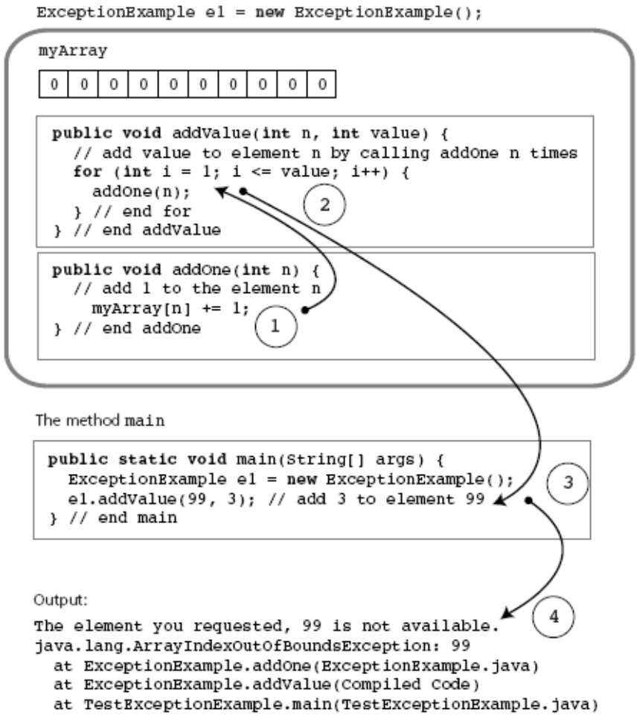
Catching Exceptions
Figure 1-9
Flow of control in a simple Java application

Slide 52
Catching Exceptions
Types of exception
  Checked exceptions
    Instances of classes that are subclasses of java.lang.Exception
    Must be handled locally or thrown by the method
    Used when method encounters a serious problem
  Runtime exceptions
    Occur when the error is not considered serious
    Instances of classes that are subclasses of java.lang.RuntimeException

Slide 53
Catching Exceptions
The finally block
  Executed whether or not an exception is thrown
  Can be used even if no catch block is used
  Syntax
    finally {
    statement(s);
    }

Slide 54
Throwing Exceptions
throws clause
  Indicates a method may throw an exception
    If an error occurs during its execution
  Syntax
    public methodName throws ExceptionClassName
throw statement
  Used to throw an exception at any time
  Syntax
    throw new exceptionClass(stringArgument);
You can define your own exception class

Slide 55
Text Input and Output
Input and output consist of streams
Streams
  Sequence of characters that either come from or go to an I/O device
  InputStream - Input stream class
  PrintStream - Output stream class
java.lang.System provides three stream variables
  System.in – standard input stream
  System.out – standard output stream
  System.err – standard error stream

Slide 56
Input
Prior to Java 1.5
  BufferedReader stdin = new BufferedReader(new InputStreamReader(System.in));
  String nextLine = stdin.readLine();
  StringTokenizer input = new StringTokenizer(nextLine);
  x = Integer.parseInt(input.nextToken());
  y = Integer.parseInt(input.nextToken());

Slide 57
Input
Java 1.5 – The Scanner class
  int nextValue;
  int sum=0;
  Scanner kbInput = new Scanner(System.in);
  nextValue = kbInput.nextInt();
  while (nextValue > 0) {
  sum += nextValue;
  nextValue = kbInput.nextInt();
  } // end while
  kbInput.close();

Slide 58
Input
Java 1.5 – The Scanner class (continued)
  More useful next methods
    String next();
    boolean nextBoolean();
    double nextDouble();
    float nextFloat();
    int nextInt();
    String nextLine();
    long nextLong();
    short nextShort();

Slide 59
Output
Methods print and println
  Write character strings, primitive types, and objects to System.out
  println terminates a line of output so next one starts on the next line
  When an object is used with these methods
    Return value of object’s toString method is displayed
    You usually override this method with your own implementation
  Problem
    Lack of formatting abilities

Slide 60
Output
Method printf
  C-style formatted output method
  Syntax
    printf(String format, Object... args)
  Example:
    String name = "Jamie";
    int x = 5, y = 6;
    int sum = x + y;
    System.out.printf("%s, %d + %d = %d", name, x, y, sum);
    //produces output Jamie, 5 + 6 = 11

Slide 61
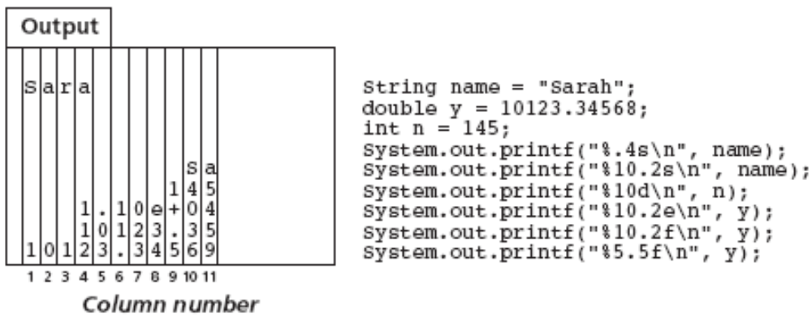
Output
Figure 1-10
Formatting example with printf

Slide 62
File Input and Output
File
  Sequence of components of the same type that resides in auxiliary storage
  Can be large and exists after program execution terminates
Files vs. arrays
  Files grow in size as needed; arrays have a fixed size
  Files provides both sequential and random access; arrays provide random access
File types
  Text and binary (general or nontext) files

Slide 63
Text Files
Designed for easy communication with people
  Flexible and easy to use
  Not efficient with respect to computer time and storage
End-of-line symbol
  Creates the illusion that a text file contains lines
End-of-file symbol
  Follows the last component in a file
Scanner class can be used to process text files

Slide 64
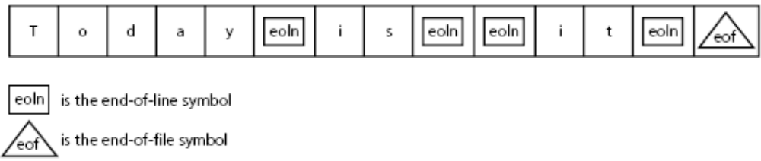
Text Files
Figure 1-11
A text file with end-of-line and end-of-file symbols

Slide 65
Text Files
Example
  String fname, lname;
  int age;
  Scanner fileInput;
  File inFile = new File("Ages.dat");
  try {
  fileInput = new Scanner(inFile);
  while (fileInput.hasNext()) {
  fname = fileInput.next();
  lname = fileInput.next();
  age = fileInput.nextInt();
  age = fileInput.nextInt();
  System.out.printf("%s %s is %d years old.\n",
  fname, lname, age);
  } // end while
  fileInput.close();
  } // end try
  catch (FileNotFoundException e) {
  System.out.println(e);
  } // end catch

Slide 66
Text Files
Open a stream to a file
  Before you can read from or write to a file
  Use class FileReader
    Constructor throws a FileNotFoundException
  Stream is usually embedded within an instance of class BufferedReader
    That provides text processing capabilities
  StringTokenizer
    Used to break up the string returned by readLine into tokens for easier processing

Slide 67
Text Files
Example
  BufferedReader input;
  StringTokenizer line;
  String inputLine;
  try {
  input = new BufferedReader(new FileReader("Ages.dat"));
  while ((inputLine = input.readLine()) != null) {
  line = new StringTokenizer(inputLine);
  // process line of data
  ...
  }
  } // end try
  catch (IOException e) {
  System.out.println(e);
  System.exit(1); // I/O error, exit the program
  } // end catch

Slide 68
Text Files
File output
  You need to open an output stream to the file
  Use class FileWriter
  Stream is usually embedded within an instance of class PrintWriter
    That provides methods print and println

Slide 69
Text Files
Example
  try {
  PrintWriter output = new PrintWriter(new FileWriter("Results.dat"));
  output.println("Results of the survey");
  output.println("Number of males: " + numMales);
  output.println("Number of females: " + numFemales);
  // other code and output appears here...
  } // end try
  catch (IOException e) {
  System.out.println(e);
  System.exit(1); // I/O error, exit the program
  } // end catch

Slide 70
Text Files
Closing a file
  Syntax
    myStream.close();
Adding to a text file
  When opening a file, you can specify if file should be replaced or appended
  Syntax
    PrintWriter ofStream = new PrintWriter(new FileOutputStream("Results.dat", true));

Slide 71
Object Serialization
Data persistence
  Data stored in a file for later use
Object serialization
  Java mechanism to create persistent objects
Serialization
  Transforming an object into a sequence of bytes that represents the object
  Serialized objects can be stored to files for later use

Slide 72
Object Serialization
Deserialization
  Reverse process
Interface java.io.Serializable
  Needed to save an object using object serialization
  Contains no methods
Objects referenced by a serialized object are also serialized
  As long as these objects also implement the Serializable interface

Slide 73
Summary
Java packages
  Provide a mechanism for grouping related classes
import statement
  Required to use classes contained in other packages
Object in Java is an instance of a class
Class
  Data type that specifies data and methods available
  Data fields are either variables or constants
  Methods implement object behavior
Method parameters are passed by value

Slide 74
Summary
Comments in Java
  Comment lines
  Multiple-line comments
Java identifier
  Sequence of letters, digits, underscores, and dollar signs
Primitive data types categories
  Integer, character, floating point, and boolean
Java reference
  Used to locate an object

Slide 75
Summary
Define named constant with final keyword
Java uses short-circuit evaluation for logical and relational expressions
Array
  Collection of references that have the same data type
Selection statements
  if and switch
Iteration statements
  while, for, and do

Slide 76
Summary
String
  Sequence of characters
  String classes: String, StringBuffer, StringTokenizer
Exceptions
  Used to handle errors during execution
Files are accessed using Scanner class or streams
Data persistence and object serialization

